Slide 1
CHAPTER 7 Search using complex data structure

Slide 2
Definition
Searching is the process of finding the location of a given element in a set of elements.
Searching means to find whether a particular value is present in an array or not. If the value is present in the array, then searching is said to be successful and the searching process gives the location of that value in the array.
There are two simple approaches to searching:
Linear search: This method traverses a list sequentially to locate the search key.
Binary search: This method works on sorted lists by progressively making better guesses to find the location of a search key.

Slide 3
Linear search Algorithms
The linear search is also called sequential search. It is a simple method used for searching an array
for a particular value. It works by comparing the value to be searched with every element of the array one by one in a sequence until a match is found.

Slide 4
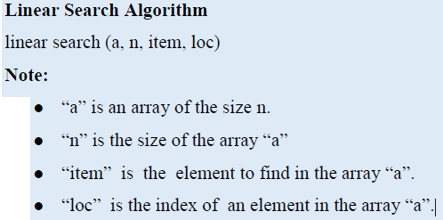
cont’d

Slide 5
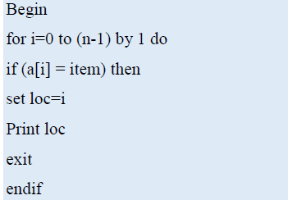
Algorithm cont’d

Slide 6
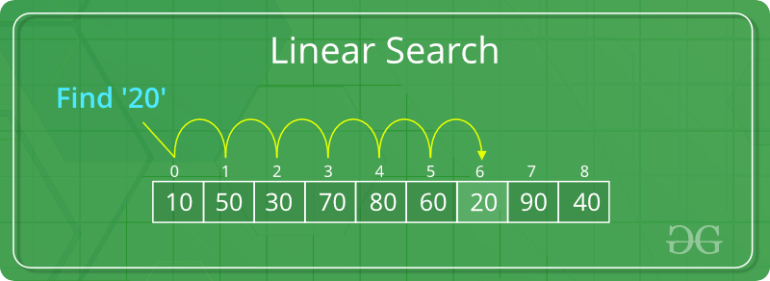
LINEAR SEARCH ILLUSTRATION

Slide 7
Linear Search…
Time Complexity: O(n)
Description: Iterates through the list/array from the beginning to find the target element.
Best Case: O(1)(when the target is found at the beginning)
Worst Case: O(n) (when the target is found at the end or not present

Slide 8
Binary Search
You search an array by repeatedly dividing the search interval in half. While dividing you begin with an interval covering the whole array. If the value of the search key is less than the item in the middle of the interval, narrow the interval to the lower half. Otherwise narrow it to the upper half.
Repeatedly check until the value is found or the interval is empty. This kind of search is also called the dichotomy method or bisection method.

Slide 9
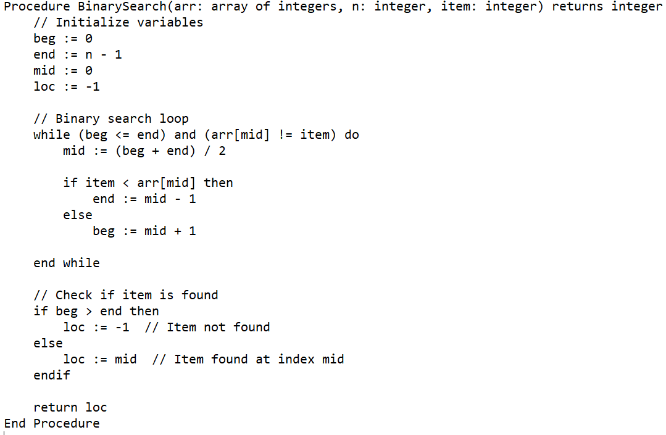
Binary search algorithm

Slide 10
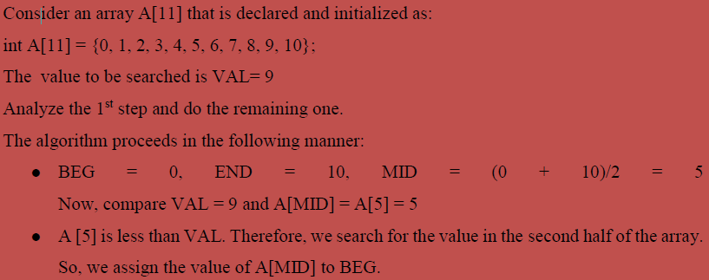
Example Activity

Slide 11
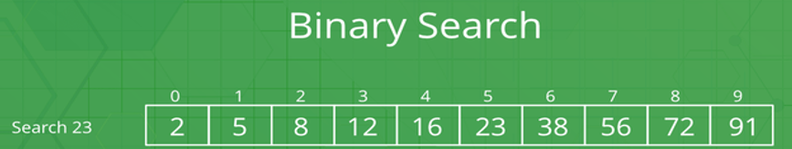

Slide 12
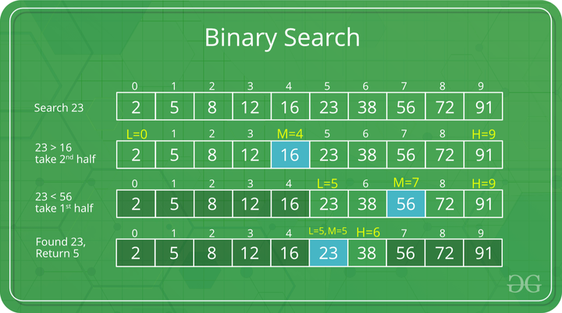
Binary Search to find the element “23” in a given list of numbers

Slide 13
Binary Search…
Time Complexity: O(log⁡n)
Description: Divides the search interval in half repeatedly until the target is found or the interval is empty.
Requires: The array must be sorted.
Best Case: O(1) (when the target is found at the middle)
Worst Case: O(log⁡n)

Slide 14
End

